Slide 1

STATS 432 Computational Statistics
Chapter 11 – Gibbs Sampling

Slide 2

11.1 – Joint, Marginal & Conditional Distributions

Slide 3

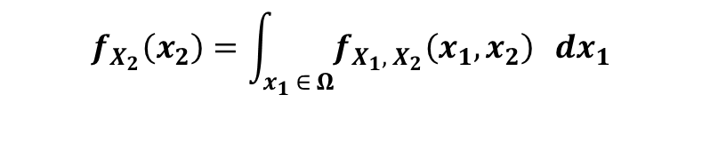

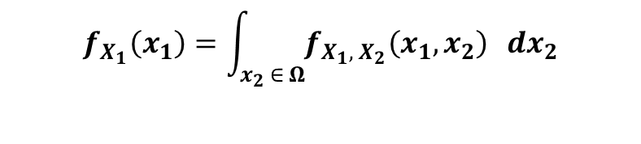


11.1a – Joint, Marginal & Conditionals in 2D:
11.1 – Joint, Marginal & Conditionals
Suppose we have two random variables $X_{1}$ and $X_{2}$ which take values in the state space $Ω⊆ℝ^{2}$ and are distributed according to the joint pdf
$$f_{X_{1}, X_{2}}\left(x_{1}, x_{2}\right)$$
The marginal pdfs for $X_{1}$ and $X_{2}$ can be obtained by ‘integrating out’ the unwanted variable
$$f_{X_{1}}\left(x_{1}\right)=\int_{x_{2} ∈ Ω}{f_{X_{1}, X_{2}}\left(x_{1}, x_{2}\right)} dx_{2}$$
$$f_{X_{2}}\left(x_{2}\right)=\int_{x_{1} ∈ Ω}{f_{X_{1}, X_{2}}\left(x_{1}, x_{2}\right)} dx_{1}$$
Describes the probability of outcomes of $X_{1}$ independent of $X_{2}$
Describes the probability of outcomes of $X_{2}$ independent of $X_{1}$
The corresponding conditional pdfs can then be obtained as*
$$f_{X_{1}| X_{2}} \left(x_{1} | x_{2}\right) = \frac{f_{X_{1}, X_{2}}\left(x_{1}, x_{2}\right)}{f_{X_{2}}\left(x_{2}\right)}$$
$$f_{X_{2}| X_{1}} \left(x_{2} | x_{1}\right) = \frac{f_{X_{1}, X_{2}}\left(x_{1}, x_{2}\right)}{f_{X_{1}}\left(x_{1}\right)}$$
Describes the probability of outcomes of $X_{1}$ conditional on the value of $X_{2}$
Describes the probability of outcomes of $X_{2}$ conditional on the value of $X_{1}$
3
*This is just the continuous analogue of $P\left(A \right| B)=P\left(A∩B\right) / P(B)$

Slide 4
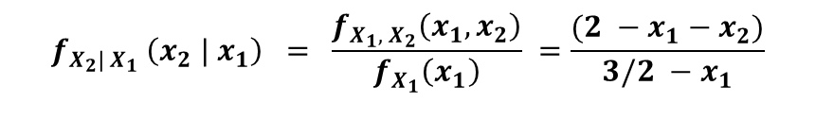
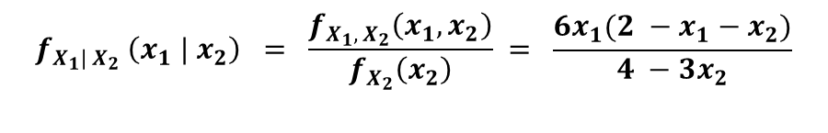
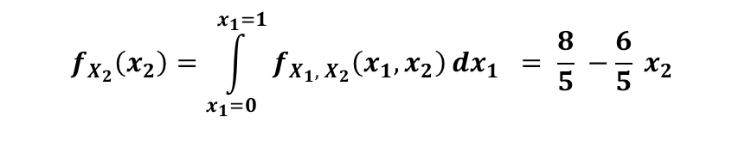
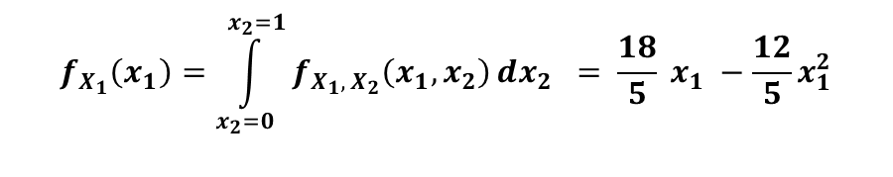
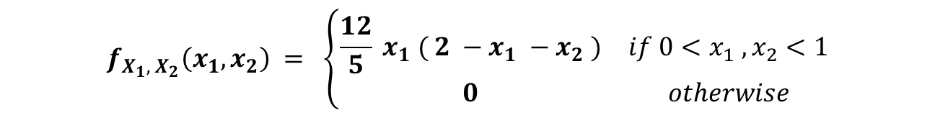
11.1a – Joint, Marginal & Conditionals in 2D:
11.1 – Joint, Marginal & Conditionals
As a specific example consider the random variables $X_{1}$ and $X_{2}$ defined by the joint pdf
$$f_{X_{1}, X_{2}}\left(x_{1}, x_{2}\right) = \left\{\begin{matrix}\frac{12}{5} x_{1} ( 2 −x_{1} −x_{2} ) & if 0<x_{1} , x_{2}<1 \\ 0 & otherwise\end{matrix}\right.$$
Using elementary integration, it can easily be shown that…
$$f_{X_{1}}\left(x_{1}\right)=\int_{x_{2}=0}^{x_{2}=1}{f_{X_{1}, X_{2}}\left(x_{1}, x_{2}\right)}dx_{2} = \frac{18}{5} x_{1} −\frac{12}{5}x_{1}^{2}$$
$$f_{X_{2}}\left(x_{2}\right)=\int_{x_{1}=0}^{x_{1}=1}{f_{X_{1}, X_{2}}\left(x_{1}, x_{2}\right)}dx_{1} = \frac{8}{5} −\frac{6}{5} x_{2}$$
and hence…
$$f_{X_{1}| X_{2}} \left(x_{1} | x_{2}\right) = \frac{f_{X_{1}, X_{2}}\left(x_{1}, x_{2}\right)}{f_{X_{2}}\left(x_{2}\right)} = \frac{6x_{1}(2 −x_{1}−x_{2})}{4 −3x_{2}}$$
$$f_{X_{2}| X_{1}} \left(x_{2} | x_{1}\right) = \frac{f_{X_{1}, X_{2}}\left(x_{1}, x_{2}\right)}{f_{X_{1}}\left(x_{1}\right)} =\frac{(2 −x_{1}−x_{2})}{3/2 −x_{1}}$$
4

Slide 5

11.1b – Joint, Marginal & Conditionals in nD:
11.1 – Joint, Marginal & Conditionals
Suppose we have $p$ random variables $X_{1}, …,X_{p}$ which take values in the state space $Ω⊆ℝ^{p}$ and are distributed according to the joint pdf
$$f_{X_{1}, …, X_{p}}\left(x_{1}, …,x_{p}\right)$$
The marginal pdf for all variables except $X_{i}$ can be found by integrating out $X_{i}$ *
$$f_{X_{−i}}\left(x_{1}, x_{2} , …, x_{i−1}, x_{i+1}, …,x_{p}\right)=\int_{x_{i} ∈ Ω}{f_{X_{1}, …, X_{p}}\left(x_{1}, …,x_{p}\right)} dx_{i}$$
The conditional distribution for $X_{i} | X_{−i}$ (i.e. for $X_{i}$ conditional on all other variables) can then be obtained as*
$$f_{X_{i}| X_{−i}} \left(x_{i} | x_{−i}\right) = \frac{f_{X_{1}, …, X_{p}}\left(x_{1}, …,x_{p}\right)}{f_{X_{−i}}\left(x_{1}, x_{2} , …, x_{i−1}, x_{i+1}, …,x_{p}\right)}$$
5
*$X_{−i}$ is shorthand notation for all variables except $X_{i}$

Slide 6
11.2 – A Motivating Example

Slide 7
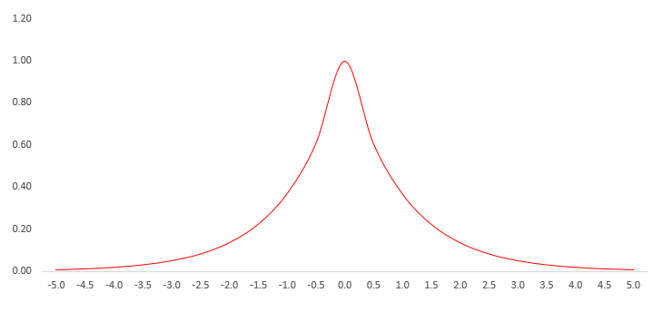
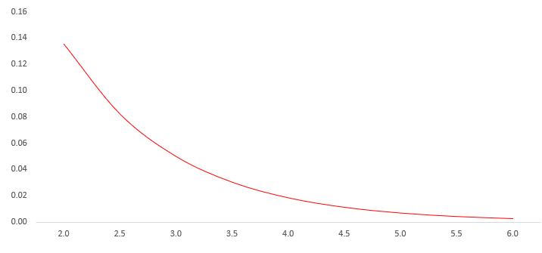


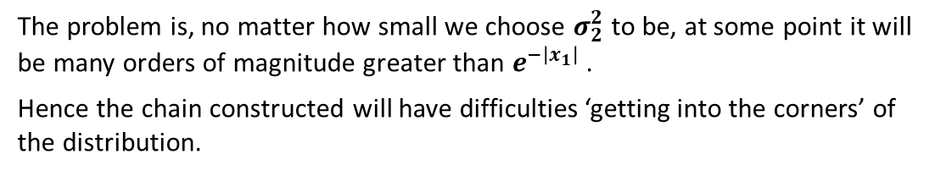

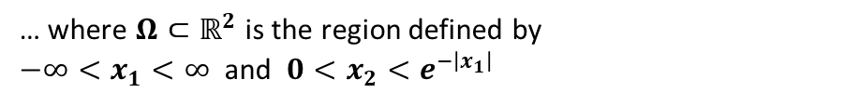


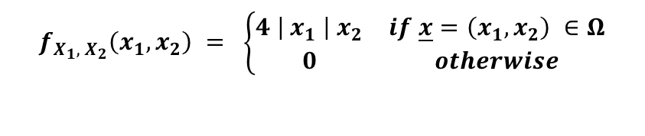


11.2 – Motivating Example:
11.2 – Motivating Example
Consider the random variables $X_{1}$ and $X_{2}$ defined by the joint pdf…
$$f_{X_{1}, X_{2}}\left(x_{1}, x_{2}\right) = \left\{\begin{matrix}4 \left| x_{1} \right| x_{2} & if \underline{x}=\left(x_{1}, x_{2}\right) ∈Ω \\ 0 & otherwise\end{matrix}\right.$$
… where $Ω⊂ℝ^{2}$ is the region defined by
$−∞<x_{1}<∞$ and $0<x_{2}<e^{−\left|x_{1}\right|}$
$$e^{−\left|x_{1}\right|}$$
$$Ω$$
Consider trying to obtain a sample of observations drawn from this distribution using a 2D normal random walk sampler within the context of the Metropolis-Hastings algorithm. We may attempt to propose new states of the chain
$X_{1}^{(t)}$ using $N( X_{1}^{\left(t−1\right)}, σ_{1}^{2} )$
and
$X_{2}^{(t)}$ using $N( X_{2}^{\left(t−1\right)}, σ_{2}^{2} )$
The problem is, no matter how small we choose $σ_{2}^{2}$ to be, at some point it will be many orders of magnitude greater than $e^{−\left|x_{1}\right|}$.
Hence the chain constructed will have difficulties ‘getting into the corners’ of the distribution.
$\left(\begin{matrix}X_{1}^{\left(t−1\right)} \\ X_{2}^{\left(t−1\right)}\end{matrix}\right)$
$$σ_{2}^{2}$$
$$e^{−\left|x_{1}\right|}$$

Slide 8
11.2 – Motivating Example:
11.2 – Motivating Example
This is an example of a situation whereby it is difficult to produce a proposal density that will update all variables simultaneously in an efficient way.
Whilst the difficulties are not insurmountable in this instance, higher dimensional problems with more complicated n-dimensional domains $Ω⊂ℝ^{n}$ can be intractable.
In such instances, we might be able to use the idea of Gibbs Sampling whereby new states in the chain are proposed one variable (or a handful of variables) at a time using their conditional distributions.
However, in order to apply Gibbs Sampling:
We have to know what those conditional distributions are a priori
The conditional distributions must have some ‘nice’ parametric form from which we can easily sample.
8

Slide 9
11.3 – Gibbs Sampling

Slide 10
11.3a – Gibbs Sampling Overview:
11.3 – Gibbs Sampling
Gibbs Sampling is a MCMC method commonly used in multi-dimensional settings whereby it is hard to update all variables simultaneously.
Originally developed by Geman & Geman (1984)¹ for application to the Gibbs distribution (used in image processing), it was later popularised by Gelfand & Smith (1990)² who suggested applying it to other distributions.
Gibbs Sampling is a special case of the Metropolis-Hastings algorithm whereby:
Instead of new states for all variables being proposed simultaneously, new states are proposed one variable (or a handful of variables) at a time using their conditional distributions.
The acceptance probability is always equal to one, such that the ‘acceptance stage’ of the algorithm can be omitted.
In order to apply Gibbs Sampling:
We have to know the required conditional distributions a priori.
The conditional distributions must have some ‘nice’ parametric form from which we can easily sample.
We still have to check that the chain has converged to the target distribution using all the convergence diagnostics we learned about in the last lecture!
10
¹ Geman, S. and Geman, D. 1984. Stochastic Relaxation, Gibbs Distributions and the Bayesian Restoration of Images. IEEE Transactions on Pattern Analysis and Machine Intelligence, 6: 721–741.
² Gelfand, A. E., & Smith, A. F. (1990). ‘Sampling-based approaches to calculating marginal densities’. Journal of the American Statistical Association, 85(410), 398-409.

Slide 11

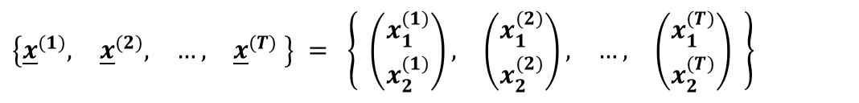

11.3b – Gibbs Sampling Algorithm in 2D:
11.3 – Gibbs Sampling
Given two random variables $X_{1}$ and $X_{2}$ with joint probability density function $f_{X_{1}, X_{2}}\left(x_{1}, x_{2}\right)$ and corresponding conditional densities…
$$f_{X_{1}| X_{2}} \left(x_{1} | x_{2}\right) = \frac{f_{X_{1}, X_{2}}\left(x_{1}, x_{2}\right)}{f_{X_{2}}\left(x_{2}\right)}$$
$$f_{X_{2}| X_{1}} \left(x_{2} | x_{1}\right) = \frac{f_{X_{1}, X_{2}}\left(x_{1}, x_{2}\right)}{f_{X_{1}}\left(x_{1}\right)}$$
… the Gibbs Sampling algorithm can be described as follows.
Step 1:
Specify an initial value ${\underline{x}}^{(1)}= \left(\begin{matrix}x_{1}^{(1)}, & x_{2}^{(1)}\end{matrix}\right)$
Step 2:
For $t=2, …, T$ (where $T$ is large).
Suppose the chain is currently at ${\underline{x}}^{(t−1)}= \left(x_{1}^{(t−1)} ,{ x}_{2}^{(t−1)}\right)$
Generate $x_{1}^{(t)} \sim f_{X_{1}| X_{2}} \left(x_{1} | x_{2}^{(t−1)}\right)$
Note that in 2D examples conditional densities are univariate making them much easier to sample from compared to nD examples.
Generate $x_{2}^{(t)} \sim f_{X_{2}| X_{1}} \left(x_{2} | x_{1}^{(t)}\right)$
Step 3:
Return the values
$$\left\{\begin{matrix}{\underline{x}}^{(1)}, & {\underline{x}}^{(2)}, & \begin{matrix}…, & {\underline{x}}^{(T)}\end{matrix}\end{matrix} \right\} = \left\{ \begin{matrix}\left(\begin{matrix}x_{1}^{(1)} \\ x_{2}^{(1)}\end{matrix}\right), & \left(\begin{matrix}x_{1}^{(2)} \\ x_{2}^{(2)}\end{matrix}\right), & \begin{matrix}…, & \left(\begin{matrix}x_{1}^{(T)} \\ x_{2}^{(T)}\end{matrix}\right)\end{matrix}\end{matrix} \right\}$$
11

Slide 12
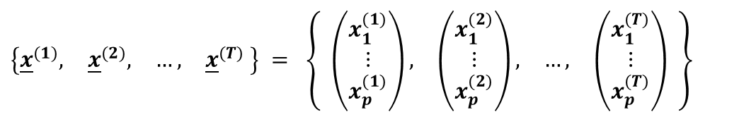


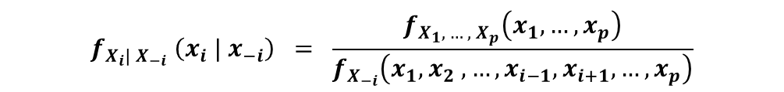

11.3c – Gibbs Sampling Algorithm in nD:
11.3 – Gibbs Sampling
Given $p$ random variables $X_{1},…,X_{p}$ with joint probability density function $f_{X_{1}, …, X_{p}}\left(x_{1}, …,x_{p}\right)$ with corresponding conditional densities…
$$f_{X_{i}| X_{−i}} \left(x_{i} | x_{−i}\right) = \frac{f_{X_{1}, …, X_{p}}\left(x_{1}, …,x_{p}\right)}{f_{X_{−i}}\left(x_{1}, x_{2} , …, x_{i−1}, x_{i+1}, …,x_{p}\right)}$$
… the Gibbs Sampling algorithm can be described as follows.
Step 1:
Specify an initial value ${\underline{x}}^{(1)}= \left(\begin{matrix}x_{1}^{(1)}, & \begin{matrix}x_{2}^{(1)}, & …, & x_{p}^{(1)}\end{matrix}\end{matrix}\right)$
Step 2:
For $t=2, …, T$ (where $T$ is large)
Suppose the chain is currently at ${\underline{x}}^{(t−1)}= \left(x_{1}^{(t−1)} ,{ x}_{2}^{(t−1)}, …,{ x}_{p}^{(t−1)}\right)$
Generate $x_{1}^{(t)} \sim f_{X_{1}| X_{−1}} \left(x_{1} | \begin{matrix}x_{2}^{(t−1)}, & x_{3}^{(t−1)}, & \begin{matrix}…, & x_{p}^{(t−1)}\end{matrix}\end{matrix}\right)$
Generate $x_{2}^{(t)} \sim f_{X_{2}| X_{−2}} \left(x_{2} | \begin{matrix}x_{1}^{(t)}, & x_{3}^{(t−1)}, & \begin{matrix}…, & x_{p}^{(t−1)}\end{matrix}\end{matrix}\right)$
Generate $x_{3}^{(t)} \sim f_{X_{3}| X_{−3}} \left(x_{3} | \begin{matrix}x_{1}^{(t)}, & x_{2}^{(t)}, & \begin{matrix}…, & x_{p}^{(t−1)}\end{matrix}\end{matrix}\right)$
$$⋮$$
$$⋮$$
$$⋮$$
Generate $x_{p}^{(t)} \sim f_{X_{p}| X_{−p}} \left(x_{p} | \begin{matrix}x_{1}^{(t)}, & x_{2}^{(t)}, & \begin{matrix}…, & x_{p−1}^{(t)}\end{matrix}\end{matrix}\right)$
Step 3:
Return the values
$$\left\{\begin{matrix}{\underline{x}}^{(1)}, & {\underline{x}}^{(2)}, & \begin{matrix}…, & {\underline{x}}^{(T)}\end{matrix}\end{matrix} \right\} = \left\{ \begin{matrix}\left(\begin{matrix}x_{1}^{(1)} \\ ⋮ \\ x_{p}^{(1)}\end{matrix}\right), & \left(\begin{matrix}x_{1}^{(2)} \\ ⋮ \\ x_{p}^{(2)}\end{matrix}\right), & \begin{matrix}…, & \left(\begin{matrix}x_{1}^{(T)} \\ ⋮ \\ x_{p}^{(T)}\end{matrix}\right)\end{matrix} \end{matrix} \right\}$$
12

Slide 13
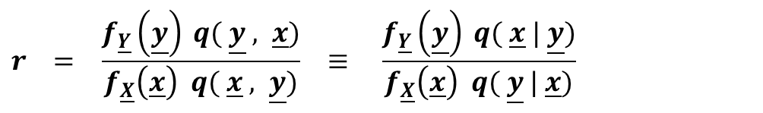

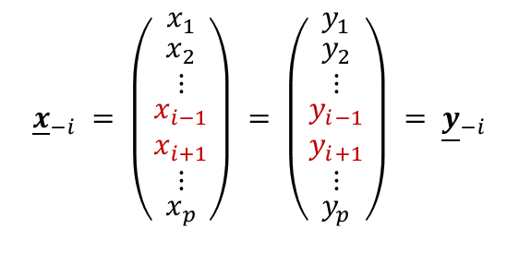
11.3d – Gibbs as a Special Case of the MH Algorithm:
11.3 – Gibbs Sampling
In the acceptance stage of the Metropolis-Hastings algorithm we calculate the acceptance ratio
$$r = \frac{f_{\underline{Y}}\left(\underline{y}\right) q( \underline{y} , \underline{x})}{f_{\underline{X}}\left(\underline{x}\right) q( \underline{x} , \underline{y})} ≡ \frac{f_{\underline{Y}}\left(\underline{y}\right) q( \underline{x} | \underline{y})}{f_{\underline{X}}\left(\underline{x}\right) q( \underline{y} | \underline{x})}$$
In the case of Gibbs Sampling, if the chain is at state $\underline{y}$ and a new state $\underline{x}$ is proposed, then $\underline{x}$ and $\underline{y}$ differ only in terms of the $i^{th}$ element differs, i.e.
$${\underline{x}}_{−i} = \left(\begin{matrix}x_{1} \\ \begin{matrix}x_{2} \\ ⋮ \\ \begin{matrix}x_{i−1} \\ x_{i+1} \\ ⋮\end{matrix}\end{matrix} \\ x_{p}\end{matrix}\right) = \left(\begin{matrix}y_{1} \\ \begin{matrix}y_{2} \\ ⋮ \\ \begin{matrix}y_{i−1} \\ y_{i+1} \\ ⋮\end{matrix}\end{matrix} \\ y_{p}\end{matrix}\right) = {\underline{y}}_{−i}$$
and
$$x_{i} \sim f_{{ X}_{i} | {\underline{Y}}_{−i}} \left( x_{i} \right| {\underline{y}}_{−i} ) = f_{{ X}_{i} | {\underline{X}}_{−i}} \left( x_{i} \right| {\underline{x}}_{−i} )$$
since ${\underline{x}}_{−i} = {\underline{y}}_{−i}$
As such, we may write $q( \underline{x} | \underline{y}) = f_{{ X}_{i} | {\underline{X}}_{−i}} \left( x_{i} \right| {\underline{x}}_{−i} )$
Similarly, if the chain is at state $\underline{x}$ and a new state $\underline{y}$ is proposed, then $\underline{y}$ and $\underline{x}$ differ only in terms of the $i^{th}$ element differs.
By the same logic as above, we may write $q( \underline{y} | \underline{x}) = f_{{ Y}_{i} | {\underline{Y}}_{−i}} \left( y_{i} \right| {\underline{y}}_{−i} )$
13

Slide 14

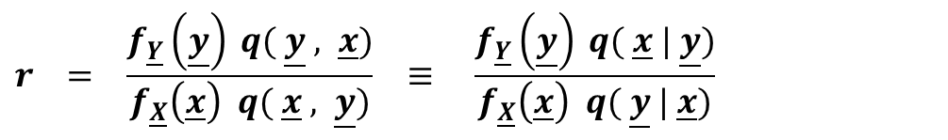
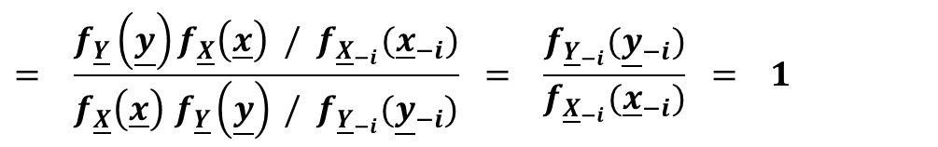
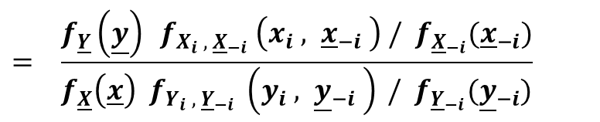
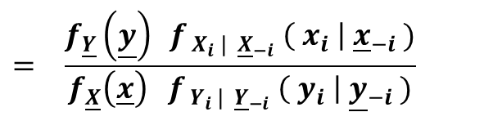

11.3d – Gibbs as a Special Case of the MH Algorithm:
11.3 – Gibbs Sampling
Consequently, the acceptance ratio simplifies to …
$$q( \underline{x} | \underline{y}) = f_{{ X}_{i} | {\underline{X}}_{−i}} \left( x_{i} \right| {\underline{x}}_{−i} )$$
$$r = \frac{f_{\underline{Y}}\left(\underline{y}\right) q( \underline{y} , \underline{x})}{f_{\underline{X}}\left(\underline{x}\right) q( \underline{x} , \underline{y})} ≡ \frac{f_{\underline{Y}}\left(\underline{y}\right) q( \underline{x} | \underline{y})}{f_{\underline{X}}\left(\underline{x}\right) q( \underline{y} | \underline{x})}$$
$$q( \underline{y} | \underline{x}) = f_{{ Y}_{i} | {\underline{Y}}_{−i}} \left( y_{i} \right| {\underline{y}}_{−i} )$$
$$= \frac{f_{\underline{Y}}\left(\underline{y}\right) f_{{ X}_{i} | {\underline{X}}_{−i}} \left( x_{i} \right| {\underline{x}}_{−i} )}{f_{\underline{X}}\left(\underline{x}\right) f_{{ Y}_{i} | {\underline{Y}}_{−i}} \left( y_{i} \right| {\underline{y}}_{−i} )}$$
See previous slide.
$$= \frac{f_{\underline{Y}}\left(\underline{y}\right) f_{X_{i} , {\underline{X}}_{−i}} \left(x_{i} , {\underline{x}}_{−i} \right) / f_{{\underline{X}}_{−i}}({\underline{x}}_{−i})}{f_{\underline{X}}\left(\underline{x}\right) f_{Y_{i} , {\underline{Y}}_{−i}} \left(y_{i} , {\underline{y}}_{−i} \right) / f_{{\underline{Y}}_{−i}}({\underline{y}}_{−i})}$$
By the laws of conditional probability.
$$= \frac{f_{\underline{Y}}\left(\underline{y}\right)f_{\underline{X}}\left(\underline{x}\right) / f_{{\underline{X}}_{−i}}({\underline{x}}_{−i})}{f_{\underline{X}}\left(\underline{x}\right){ f}_{\underline{Y}}\left(\underline{y}\right) / f_{{\underline{Y}}_{−i}}({\underline{y}}_{−i})} = \frac{f_{{\underline{Y}}_{−i}}({\underline{y}}_{−i})}{f_{{\underline{X}}_{−i}}({\underline{x}}_{−i})} = 1$$
since ${\underline{x}}_{−i} = {\underline{y}}_{−i}$
Therefore, the Gibbs sampler candidates are always accepted (no point including an acceptance stage in the Gibbs algorithm) and the sampling consists purely of sampling from the full conditional distributions.
14

Slide 15
11.4 – Computational Examples

Slide 16

11.4a – Bivariate Exponential Example:
11.4 – Computational Examples
Consider the random variables $X_{1}$ and $X_{2}$ defined by the joint pdf…
$$f_{X_{1}, X_{2}}\left(x_{1}, x_{2}\right) = \left\{\begin{matrix}A e^{− x_{1} x_{2}} & if 0<x_{1} , x_{2}<B \\ 0 & otherwise\end{matrix}\right.$$
… where $0≪B<∞$ and $A≡A(B)$ is normalizing constant. Draw a sequence of observations from this pdf.
The value of the constant $A≡A(B)$ can be approximated numerically.
$$1 = A \int_{x_{1} = 0}^{x_{1} = B}{\int_{x_{2} = 0}^{x_{2} = B}{e^{−x_{1} x_{2}}} dx_{1} d}x_{2} ⇒ A = {\left(\int_{x=0}^{x=B}{\frac{1}{x} − \frac{1}{x} e^{−Bx} dx}\right)}^{−1}$$
If B = 9,999,999,999,999 then $A≈{\left(60.4444\right)}^{−1} ≈0.016544$
16
Associated Code = 11.4a - Gibbs Sampling (2D Exponential Example)

Slide 17
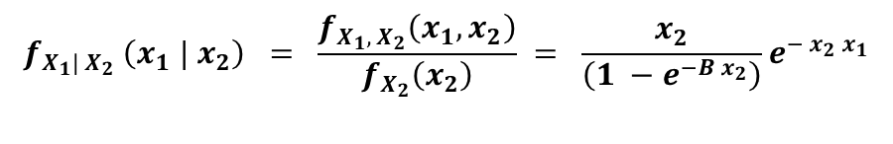
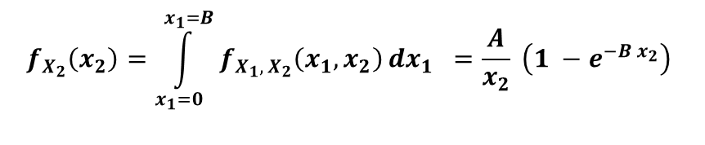
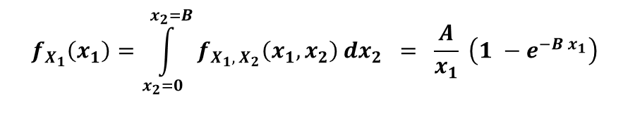
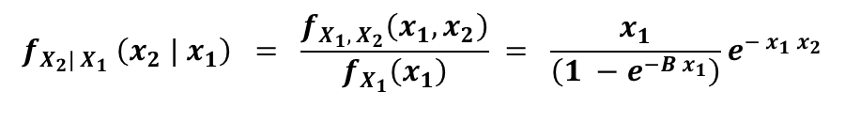
11.4a – Bivariate Exponential Example:
11.4 – Computational Examples
Consider the random variables $X_{1}$ and $X_{2}$ defined by the joint pdf…
$$f_{X_{1}, X_{2}}\left(x_{1}, x_{2}\right) = \left\{\begin{matrix}A e^{− x_{1} x_{2}} & if 0<x_{1} , x_{2}<B \\ 0 & otherwise\end{matrix}\right.$$
… where $0≪B<∞$ and $A≡A(B)$ is normalizing constant. Draw a sequence of observations from this pdf.
In this case elementary integration can be used to calculate the marginal densities…
$$f_{X_{1}}\left(x_{1}\right)=\int_{x_{2}=0}^{x_{2}=B}{f_{X_{1}, X_{2}}\left(x_{1}, x_{2}\right)}dx_{2} = \frac{A}{x_{1}} \left(1 −e^{−B x_{1}}\right)$$
$$f_{X_{2}}\left(x_{2}\right)=\int_{x_{1}=0}^{x_{1}=B}{f_{X_{1}, X_{2}}\left(x_{1}, x_{2}\right)}dx_{1} =\frac{A}{x_{2}} \left(1 −e^{−B x_{2}}\right)$$
… and hence the associated conditional distributions can be calculated as
$$f_{X_{1}| X_{2}} \left(x_{1} | x_{2}\right) = \frac{f_{X_{1}, X_{2}}\left(x_{1}, x_{2}\right)}{f_{X_{2}}\left(x_{2}\right)} = \frac{x_{2}}{\left(1 −e^{−B x_{2}}\right)}e^{− x_{2} x_{1}}$$
$$f_{X_{2}| X_{1}} \left(x_{2} | x_{1}\right) = \frac{f_{X_{1}, X_{2}}\left(x_{1}, x_{2}\right)}{f_{X_{1}}\left(x_{1}\right)} = \frac{x_{1}}{\left(1 −e^{−B x_{1}}\right)}e^{− x_{1} x_{2}}$$
Note that, in this case, the conditional distributions are known and have a ‘nice’ parametric form that can easily be sampled from since
$$X_{i} | X_{j} \sim k\left(x_{j}\right) exp⁡(x_{j})$$
=> Gibbs sampling can be used to draw observations from this pdf
17
Associated Code = 11.4a - Gibbs Sampling (2D Exponential Example)

Slide 18
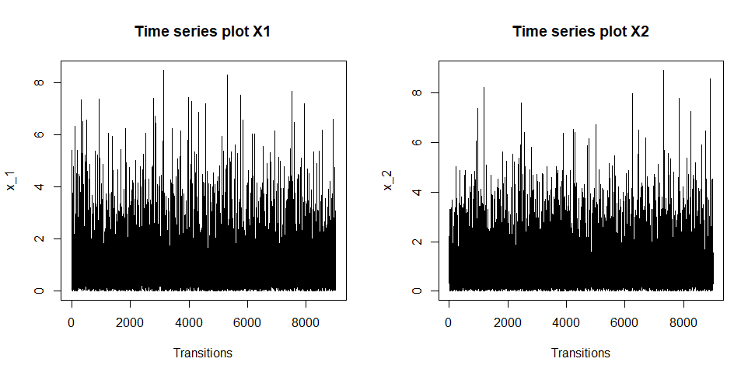
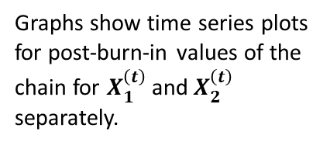
11.4a – Bivariate Exponential Example:
11.4 – Computational Examples
Graphs show time series plots for post-burn-in values of the chain for $X_{1}^{\left(t\right)}$ and $X_{2}^{\left(t\right)}$ separately.
Time series plots show quick convergence and speedy traversing of the state space (good mixing).
18
Associated Code = 11.4a - Gibbs Sampling (2D Exponential Example)

Slide 19
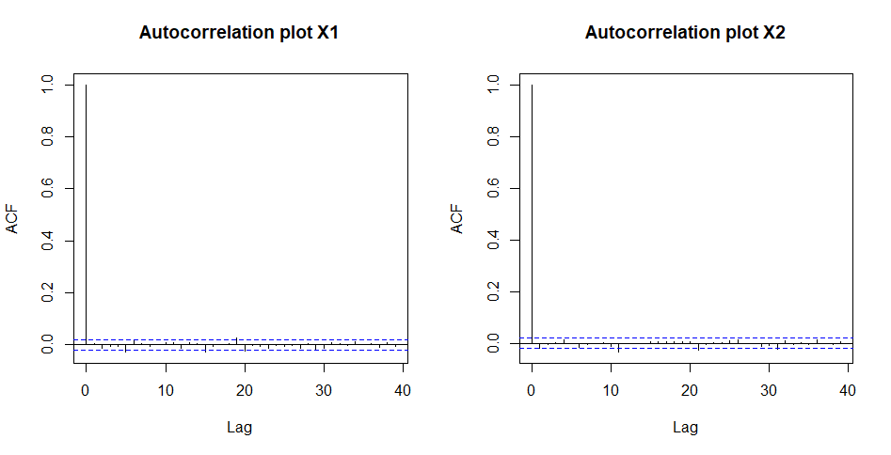
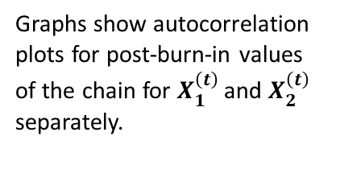
11.4a – Bivariate Exponential Example:
11.4 – Computational Examples
Graphs show autocorrelation plots for post-burn-in values of the chain for $X_{1}^{\left(t\right)}$ and $X_{2}^{\left(t\right)}$ separately.
Auto-correlation plots show low correlation for high lag values
19
Associated Code = 11.4a - Gibbs Sampling (2D Exponential Example)

Slide 20
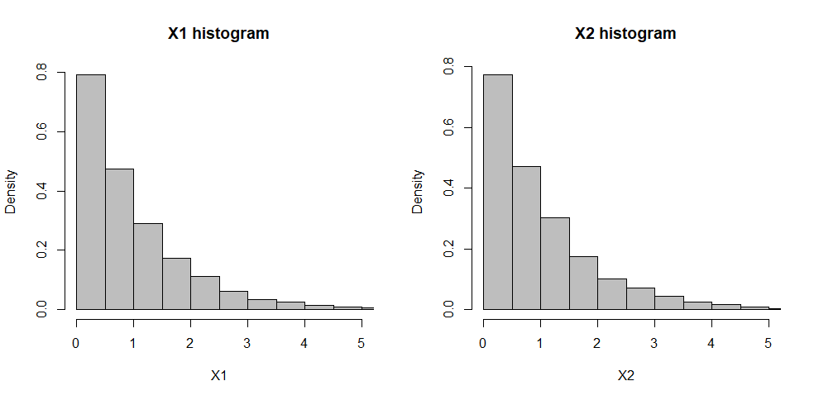
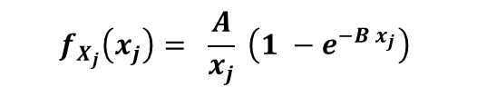
11.4a – Bivariate Exponential Example:
11.4 – Computational Examples
Histograms are of $X_{j}$ values from the chain represent the marginal density of $X_{j}$. In this case it is known that the marginal densities are given by
$$f_{X_{j}}\left(x_{j}\right)= \frac{A}{x_{j}} \left(1 −e^{−B x_{j}}\right)$$
Shape of histograms are what we would expect given what we know about the marginal distributions.
20
Associated Code = 11.4a - Gibbs Sampling (2D Exponential Example)

Slide 21
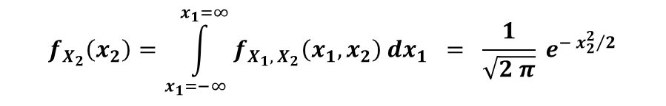
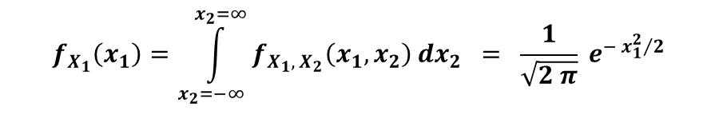
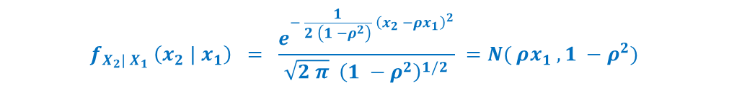
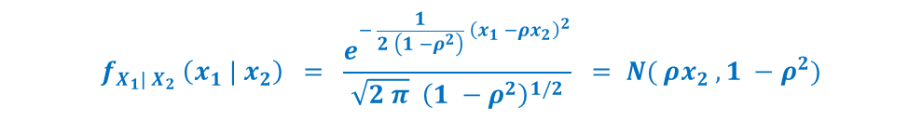
11.4b – Bivariate Normal Example:
11.4 – Computational Examples
Consider the problem of obtaining a sample of observations from the bivariate normal distribution defined by
$N( \underline{μ} , Σ )$ where $\underline{μ}={\left(0,0\right)}^{T}$ and $Σ= \left[\begin{matrix}1 & ρ \\ ρ & 1\end{matrix}\right]$
In this case the joint probability density function for $X_{1}$ and $X_{2}$ is given by …
$$f_{X_{1}, X_{2}} \left(x_{1}, x_{2}\right) = \frac{1}{2 π | Σ {\left.​\right|}^{1/2}} e^{− \frac{1}{2} \left(x_{1 }, { x}_{2}\right) Σ^{−1} {\left(x_{1 }, { x}_{2}\right)}^{T}} = \frac{1}{2 π {\left(1 −ρ^{2}\right)}^{1/2}} e^{− \frac{1}{2 \left(1 −ρ^{2}\right)} \left(x_{1}^{2} + x_{2}^{2} − 2 ρx_{1}x_{2}\right)}$$
… such that the relevant marginal densities are given by …
$$f_{X_{1}}\left(x_{1}\right)=\int_{x_{2}=−∞}^{x_{2}=∞}{f_{X_{1}, X_{2}}\left(x_{1}, x_{2}\right)}dx_{2} = \frac{1}{\sqrt{2 π}} e^{− {x_{1}^{2}}/2}$$
$$f_{X_{2}}\left(x_{2}\right)=\int_{x_{1}=−∞}^{x_{1}=∞}{f_{X_{1}, X_{2}}\left(x_{1}, x_{2}\right)}dx_{1} = \frac{1}{\sqrt{2 π}} e^{− {x_{2}^{2}}/2}$$
… and hence the associated conditional distributions can be calculated as
$$f_{X_{1}| X_{2}} \left(x_{1} | x_{2}\right) = \frac{e^{− \frac{1}{2 \left(1 −ρ^{2}\right)} {\left(x_{1} −ρx_{2}\right)}^{2}}}{\sqrt{2 π} {\left(1 −ρ^{2}\right)}^{1/2}} = N( ρx_{2} , 1 −ρ^{2})$$
$$f_{X_{2}| X_{1}} \left(x_{2} | x_{1}\right) = \frac{e^{− \frac{1}{2 \left(1 −ρ^{2}\right)} {\left(x_{2} −ρx_{1}\right)}^{2}}}{\sqrt{2 π} {\left(1 −ρ^{2}\right)}^{1/2}} =N( ρx_{1} , 1 −ρ^{2})$$
A proof of these statements is available as additional material on Blackboard (see document entitled “Additional Proofs” in relevant Course Content section
21
Associated Code = 11.4b - Gibbs Sampling (2D Normal Example)

Slide 22
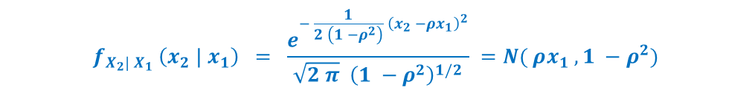
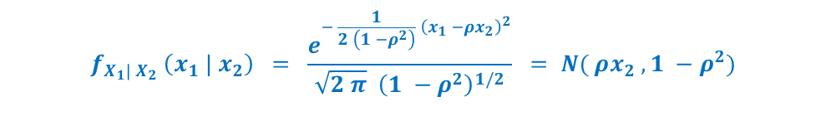
11.4b – Bivariate Normal Example:
11.4 – Computational Examples
Consider the problem of obtaining a sample of observations from the bivariate normal distribution defined by
$N( \underline{μ} , Σ )$ where $\underline{μ}={\left(0,0\right)}^{T}$ and $Σ= \left[\begin{matrix}1 & ρ \\ ρ & 1\end{matrix}\right]$
$$f_{X_{1}, X_{2}} \left(x_{1}, x_{2}\right) = \frac{1}{2 π {\left(1 −ρ^{2}\right)}^{1/2}} e^{− \frac{1}{2 \left(1 −ρ^{2}\right)} \left(x_{1}^{2} + x_{2}^{2} − 2 ρx_{1}x_{2}\right)}$$
$$f_{X_{1}| X_{2}} \left(x_{1} | x_{2}\right) = \frac{e^{− \frac{1}{2 \left(1 −ρ^{2}\right)} {\left(x_{1} −ρx_{2}\right)}^{2}}}{\sqrt{2 π} {\left(1 −ρ^{2}\right)}^{1/2}} = N( ρx_{2} , 1 −ρ^{2})$$
$$f_{X_{2}| X_{1}} \left(x_{2} | x_{1}\right) = \frac{e^{− \frac{1}{2 \left(1 −ρ^{2}\right)} {\left(x_{2} −ρx_{1}\right)}^{2}}}{\sqrt{2 π} {\left(1 −ρ^{2}\right)}^{1/2}} =N( ρx_{1} , 1 −ρ^{2})$$
The conditional distributions are known and have a ‘nice’ parametric form that can easily be sampled from since
$$X_{i} | X_{j} \sim N( ρx_{j} , 1 −ρ^{2})$$
=> Gibbs sampling can be used to draw observations from this joint pdf
22
Associated Code = 11.4b - Gibbs Sampling (2D Normal Example)

Slide 23
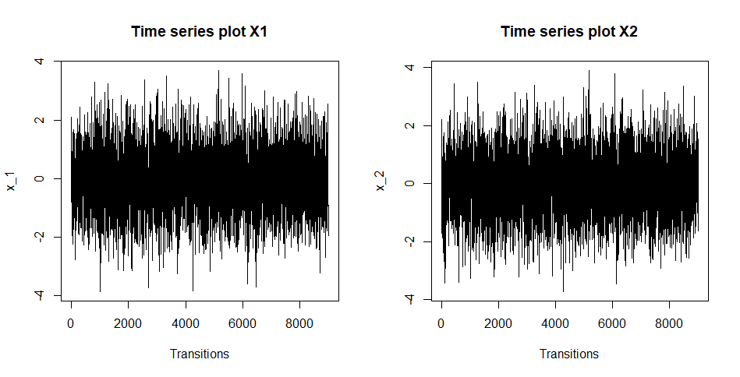
11.4b – Bivariate Normal Example:
11.4 – Computational Examples
Graphs show time series plots for post-burn-in values of the chain for $X_{1}^{\left(t\right)}$ and $X_{2}^{\left(t\right)}$ separately.
Time series plots show quick convergence and speedy traversing of the state space (good mixing).
23
Associated Code = 11.4b - Gibbs Sampling (2D Normal Example)

Slide 24
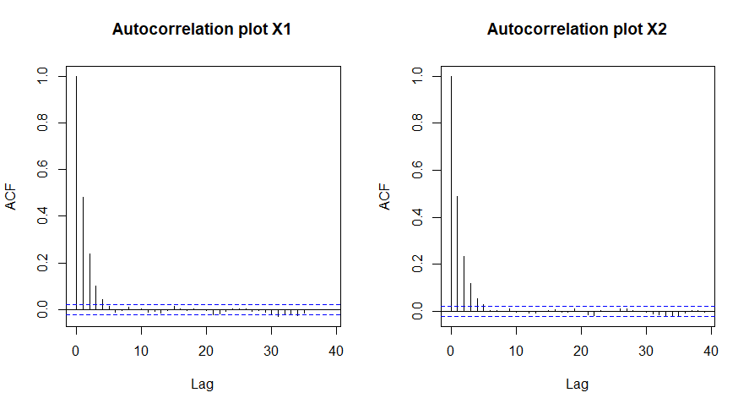
11.4b – Bivariate Normal Example:
11.4 – Computational Examples
Graphs show autocorrelation plots for post-burn-in values of the chain for $X_{1}^{\left(t\right)}$ and $X_{2}^{\left(t\right)}$ separately.
Auto-correlation plots show low correlation for high lag values
24
Associated Code = 11.4b - Gibbs Sampling (2D Normal Example)

Slide 25
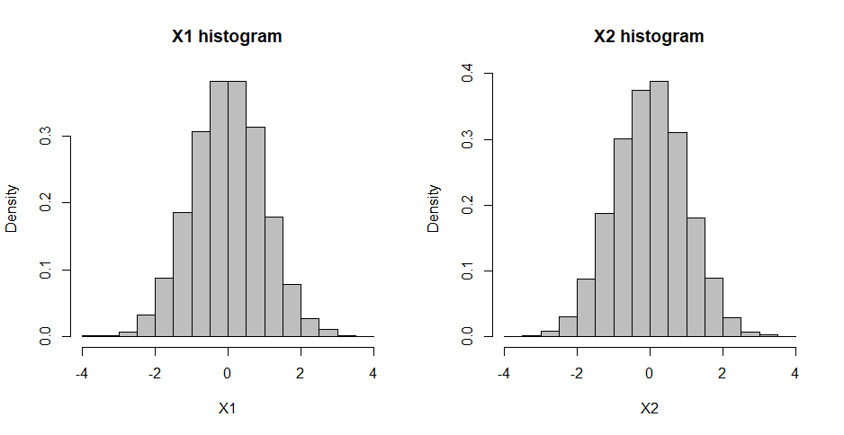

11.4b – Bivariate Normal Example:
11.4 – Computational Examples
Histograms are of $X_{j}$ values from the chain represent the marginal density of $X_{j}$. In this case it is known that the marginal densities are given by
$$f_{X_{j}}\left(x_{j}\right)= \frac{1}{\sqrt{2 π}} e^{− {x_{j}^{2}}/2}$$
Shape of histograms are what we would expect given what we know about the marginal distributions.
25
Associated Code = 11.4b - Gibbs Sampling (2D Normal Example)

Slide 26
11.5 – Final Points

Slide 27
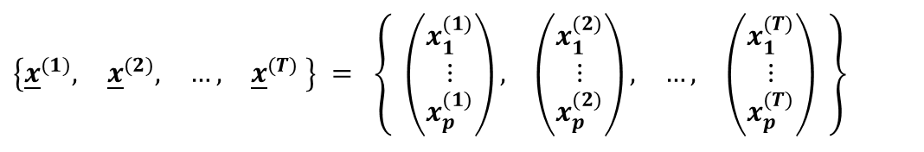



11.5a – Scanning Strategies:
11.5 – Final Points
Given $p$ random variables $X_{1},…,X_{p}$ with joint probability density function $f_{X_{1}, …, X_{p}}\left(x_{1}, …,x_{p}\right)$ with corresponding conditional densities…
$$f_{X_{i}| X_{−i}} \left(x_{i} | x_{−i}\right) = \frac{f_{X_{1}, …, X_{p}}\left(x_{1}, …,x_{p}\right)}{f_{X_{−i}}\left(x_{1}, x_{2} , …, x_{i−1}, x_{i+1}, …,x_{p}\right)}$$
… the Gibbs Sampling algorithm can be described as follows.
Step 1:
Specify an initial value ${\underline{x}}^{(1)}= \left(\begin{matrix}x_{1}^{(1)}, & \begin{matrix}x_{2}^{(1)}, & …, & x_{p}^{(1)}\end{matrix}\end{matrix}\right)$
Step 2:
For $t=2, …, T$ (where $T$ is large)
Generate $x_{1}^{(t)} \sim f_{X_{1}| X_{−1}} \left(x_{1} | \begin{matrix}x_{2}^{(t−1)}, & x_{3}^{(t−1)}, & \begin{matrix}…, & x_{p}^{(t−1)}\end{matrix}\end{matrix}\right)$
Don’t need to update variables one at a time.
Can update variables in blocks of 2 or more.
This can be especially useful if the variables within the blocks are correlated.
Generate $x_{2}^{(t)} \sim f_{X_{2}| X_{−2}} \left(x_{2} | \begin{matrix}x_{1}^{(t)}, & x_{3}^{(t−1)}, & \begin{matrix}…, & x_{p}^{(t−1)}\end{matrix}\end{matrix}\right)$
Generate $x_{3}^{(t)} \sim f_{X_{3}| X_{−3}} \left(x_{3} | \begin{matrix}x_{1}^{(t)}, & x_{2}^{(t)}, & \begin{matrix}…, & x_{p}^{(t−1)}\end{matrix}\end{matrix}\right)$
$$⋮$$
$$⋮$$
$$⋮$$
Also don’t need to update the variables in the order described here… Scanning Strategies.
Generate $x_{p}^{(t)} \sim f_{X_{p}| X_{−p}} \left(x_{p} | \begin{matrix}x_{1}^{(t)}, & x_{2}^{(t)}, & \begin{matrix}…, & x_{p−1}^{(t)}\end{matrix}\end{matrix}\right)$
Step 3:
Return the values
$$\left\{\begin{matrix}{\underline{x}}^{(1)}, & {\underline{x}}^{(2)}, & \begin{matrix}…, & {\underline{x}}^{(T)}\end{matrix}\end{matrix} \right\} = \left\{ \begin{matrix}\left(\begin{matrix}x_{1}^{(1)} \\ ⋮ \\ x_{p}^{(1)}\end{matrix}\right), & \left(\begin{matrix}x_{1}^{(2)} \\ ⋮ \\ x_{p}^{(2)}\end{matrix}\right), & \begin{matrix}…, & \left(\begin{matrix}x_{1}^{(T)} \\ ⋮ \\ x_{p}^{(T)}\end{matrix}\right)\end{matrix} \end{matrix} \right\}$$
27

Slide 28
11.5a – Scanning Strategies:
11.5 – Final Points
Given $p$ random variables $X_{1},…,X_{p}$ with joint probability density function $f_{X_{1}, …, X_{p}}\left(x_{1}, …,x_{p}\right)$ with corresponding conditional densities…
$$f_{X_{i}| X_{−i}} \left(x_{i} | x_{−i}\right) = \frac{f_{X_{1}, …, X_{p}}\left(x_{1}, …,x_{p}\right)}{f_{X_{−i}}\left(x_{1}, x_{2} , …, x_{i−1}, x_{i+1}, …,x_{p}\right)}$$
… the Gibbs Sampling algorithm can be described as follows.
Step 1:
Specify an initial value ${\underline{x}}^{(1)}= \left(\begin{matrix}x_{1}^{(1)}, & \begin{matrix}x_{2}^{(1)}, & …, & x_{p}^{(1)}\end{matrix}\end{matrix}\right)$
Step 2:
For $t=2, …, T$ (where $T$ is large)
Generate $x_{1}^{(t)} \sim f_{X_{1}| X_{−1}} \left(x_{1} | \begin{matrix}x_{2}^{(t−1)}, & x_{3}^{(t−1)}, & \begin{matrix}…, & x_{p}^{(t−1)}\end{matrix}\end{matrix}\right)$
Don’t need to update variables one at a time.
Can update variables in blocks of 2 or more.
This can be especially useful if the variables within the blocks are correlated.
Generate $x_{2}^{(t)} \sim f_{X_{2}| X_{−2}} \left(x_{2} | \begin{matrix}x_{1}^{(t)}, & x_{3}^{(t−1)}, & \begin{matrix}…, & x_{p}^{(t−1)}\end{matrix}\end{matrix}\right)$
Generate $x_{3}^{(t)} \sim f_{X_{3}| X_{−3}} \left(x_{3} | \begin{matrix}x_{1}^{(t)}, & x_{2}^{(t)}, & \begin{matrix}…, & x_{p}^{(t−1)}\end{matrix}\end{matrix}\right)$
$$⋮$$
$$⋮$$
$$⋮$$
Also don’t need to update the variables in the order described here… Scanning Strategies.
Generate $x_{p}^{(t)} \sim f_{X_{p}| X_{−p}} \left(x_{p} | \begin{matrix}x_{1}^{(t)}, & x_{2}^{(t)}, & \begin{matrix}…, & x_{p−1}^{(t)}\end{matrix}\end{matrix}\right)$
Step 3:
Return the values
$$\left\{\begin{matrix}{\underline{x}}^{(1)}, & {\underline{x}}^{(2)}, & \begin{matrix}…, & {\underline{x}}^{(T)}\end{matrix}\end{matrix} \right\} = \left\{ \begin{matrix}\left(\begin{matrix}x_{1}^{(1)} \\ ⋮ \\ x_{p}^{(1)}\end{matrix}\right), & \left(\begin{matrix}x_{1}^{(2)} \\ ⋮ \\ x_{p}^{(2)}\end{matrix}\right), & \begin{matrix}…, & \left(\begin{matrix}x_{1}^{(T)} \\ ⋮ \\ x_{p}^{(T)}\end{matrix}\right)\end{matrix} \end{matrix} \right\}$$
28

Slide 29
11.5a – Scanning Strategies:
11.5 – Final Points
Deterministic Full Scan: At each iteration, generate new states for each variable (or blocks of variables) in turn, in fixed order.
Deterministic Scan with Reversibility: At each iteration, generate new states in fixed order, and again in reverse order (i.e. 2p new states in each iteration).
Random Scan: at each iteration, generate random order of p variables and generate new states in that order.
Single Component Random Scan: At each iteration, pick one variable at random and generate a new state to only update that variable.
29

Slide 30
11.5b – Disadvantages:
11.5 – Final Points
In order to apply Gibbs Sampling:
We have to know what those conditional distributions are a priori
The conditional distributions must have some ‘nice’ parametric form from which we can easily sample.
It is not always straight forward to sample from multi-dimensional conditional distributions.
Since variables in the chain are updated sequentially rather than simultaneously, the Gibbs algorithm tends to take longer to run than the Metropolis-Hasting’s algorithm.
As the number of variables increases, the chain tends to converge more slowly.
We still need to conduct all the relevant convergence diagnostics to assess whether the chain has converged to the target (joint) distribution. We didn’t do any convergence diagnostics here just to save time.
30

